Slide 1
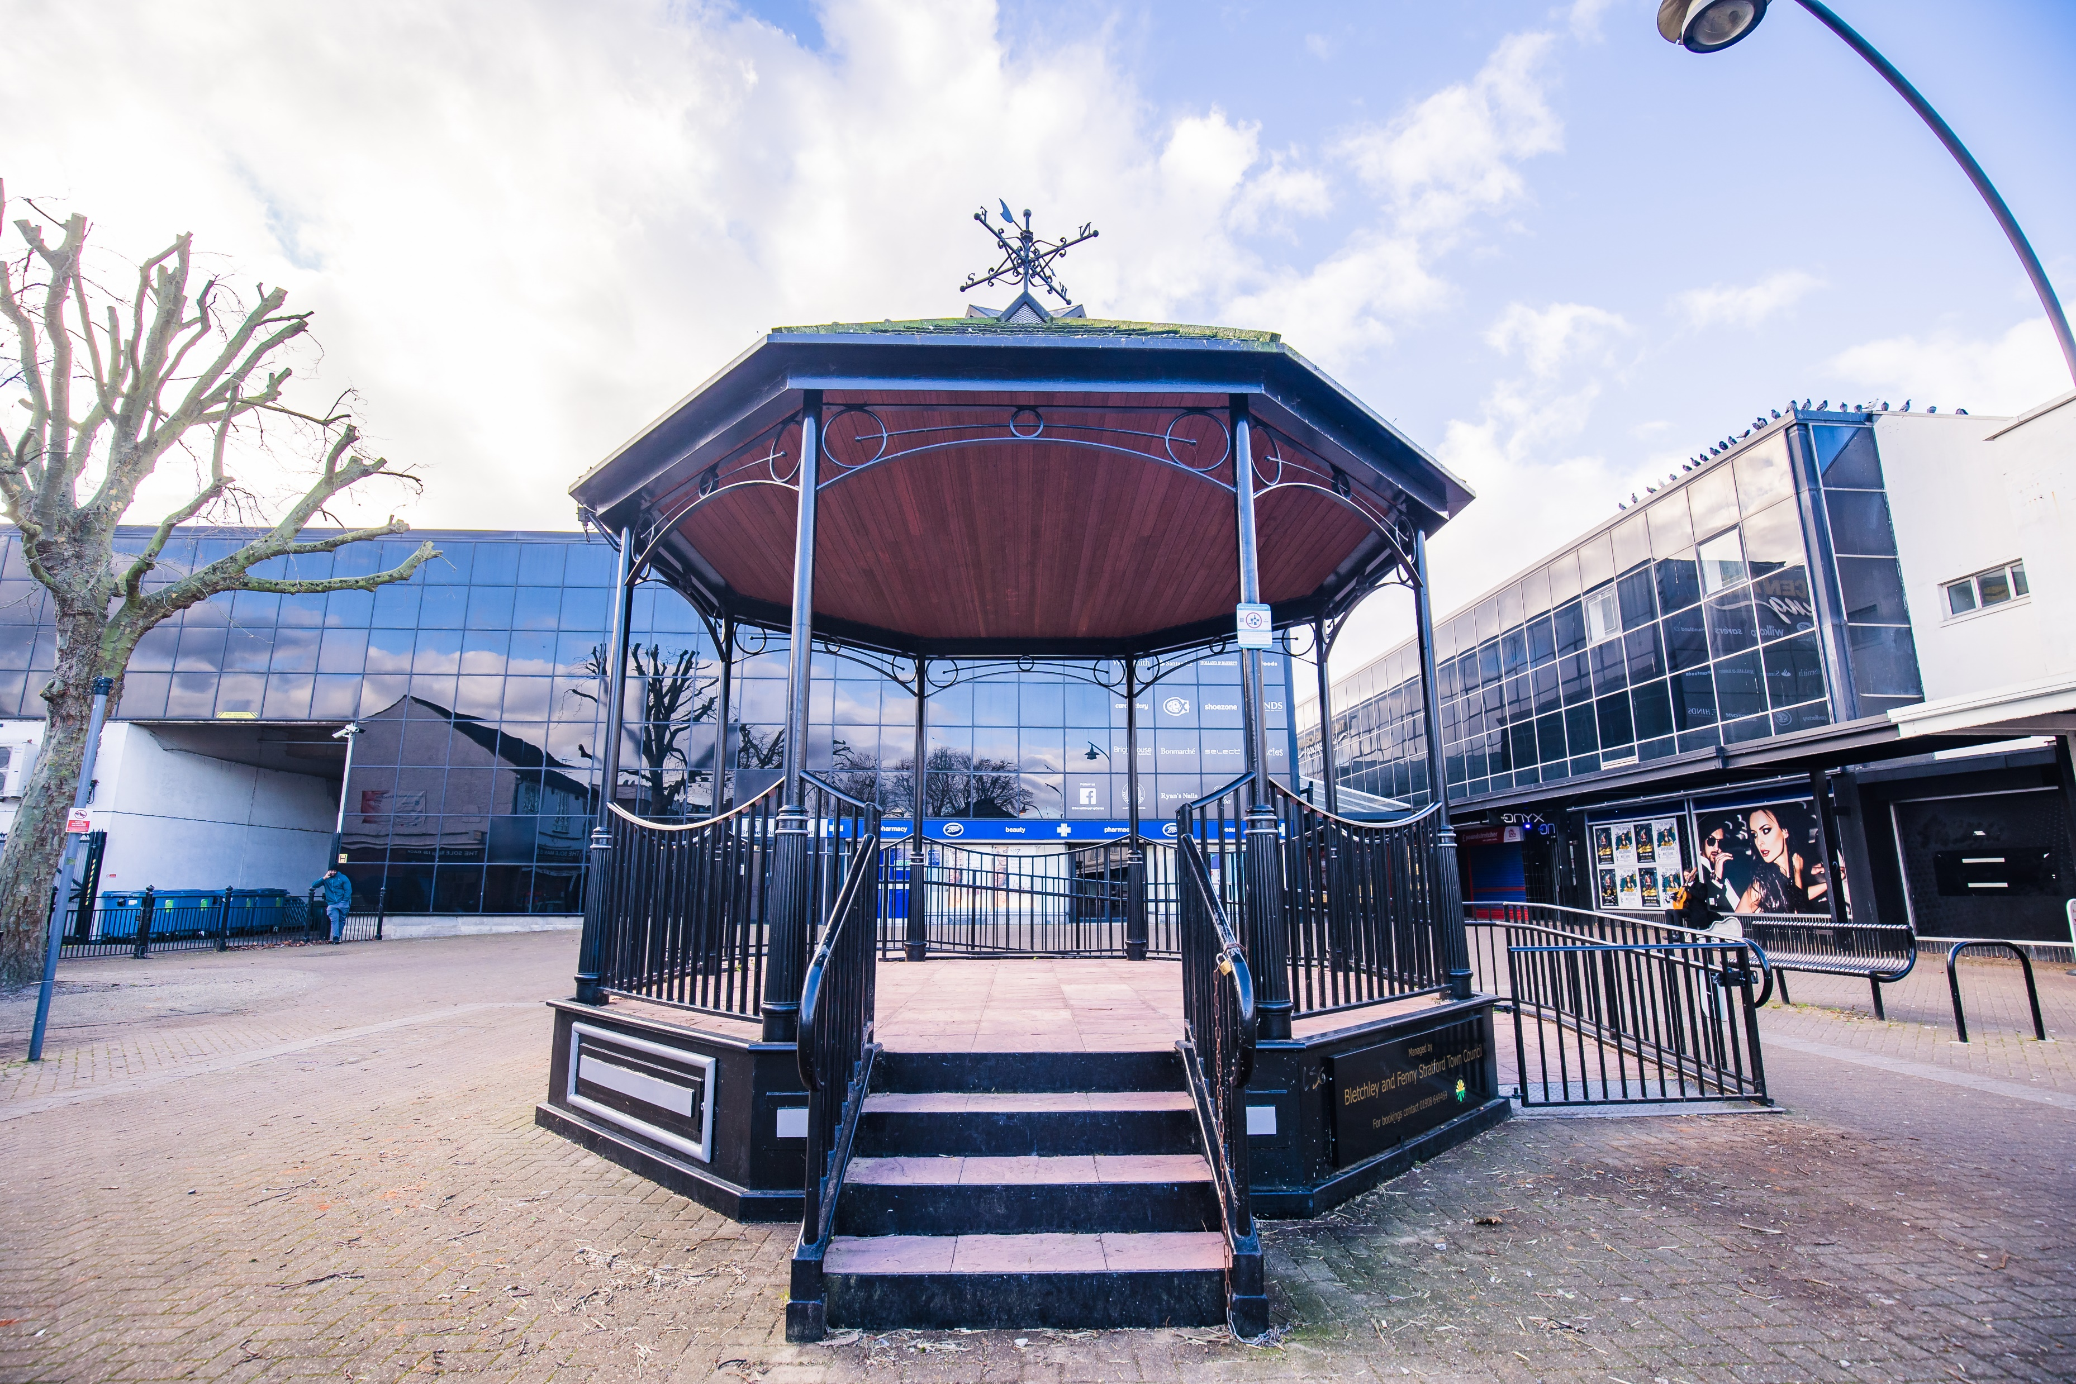

Bletchley and Fenny Stratford Town Council
2023 - 2024

Slide 2
Key themes for 2023- 2024
Future development of Bletchley and Fenny Stratford
Neighbourhood Plan
Partnership working – eg Town Deal, Bletchley Pathfinder
Need for public spaces for local service delivery – Sycamore Buildings Project
Improved community engagement and consultation
Notes:
Over the past year the Community Committee have been very busy introducing new events, providing grants to various organisations and supporting the ongoing health and wellbeing needs of the Town including the free swimming and counselling sessions.
Highlights for the year have been the themed markets, Bletchley Big Street Eat, Christmas on Queensway and our newest event that reaches in to our diverse community, namely Iftar that was well attended and appreciated.
Grants this year included Bletchley and Fenny Stratford Town Council be the main sponsor of Fenny Poppers, the Electra Community boat, Canal festival and organisations such as YMCAs Soup Recipe book

Slide 3
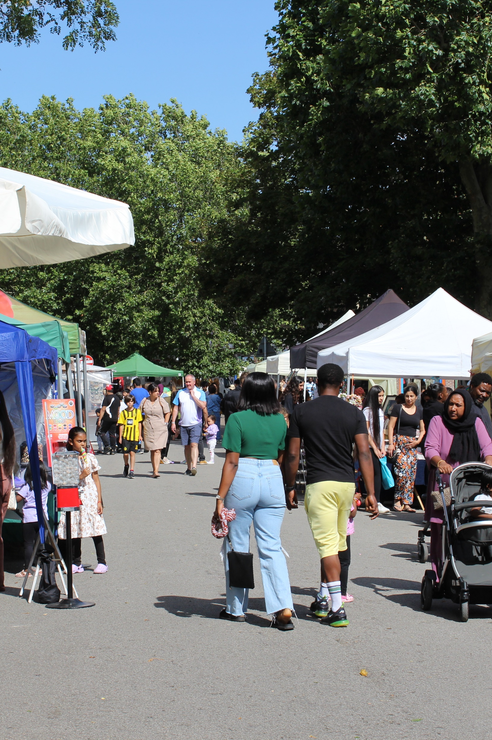
Community
Committee
Year 2023 - 2024
Terry Stephens – Chair
Mariee Wymer – Vice Chair

Slide 4
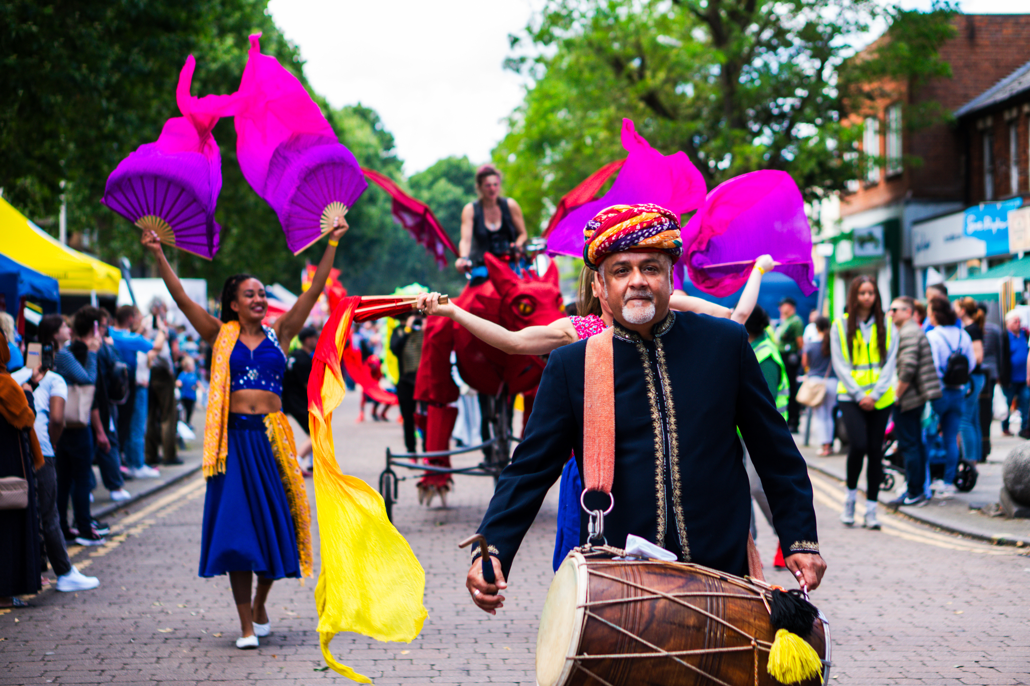
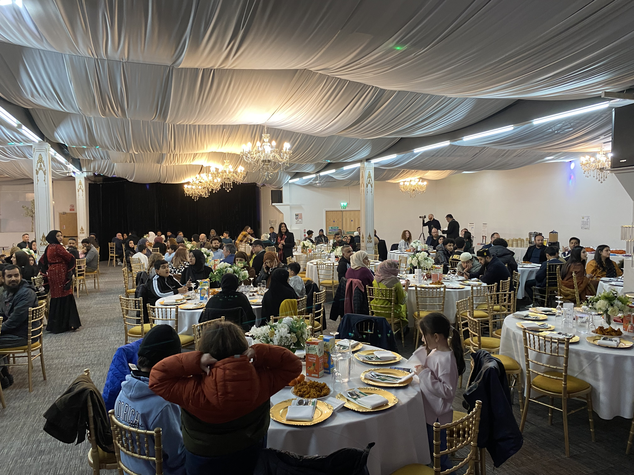
Events
Bletchley Big Street Eat – Family Friendly, celebrate culture and community. 60 local and independent stalls.
Christmas on Queensway – Popular event, that included music, fun, crafts, train rides, fun run, pantomime and of course Santa in his Grotto.
Community Iftar – We hosted our newest event that reaches into our diverse community to recognise the meal eaten by Muslims at sunset to break their fast during Ramadan. Well attended, appreciated, delicious food and some thoughtful speeches. Open to all faiths.
Easter and Halloween – Including treasure hunts, fancy dress, characters in costumes.
Themed Markets – Bringing additional footfall to Queensway including a popular Vegan market.
Notes:
Over the past year the Community Committee have been very busy introducing new events, providing grants to various organisations and supporting the ongoing health and wellbeing needs of the Town including the free swimming and counselling sessions.
Highlights for the year have been the themed markets, Bletchley Big Street Eat, Christmas on Queensway and our newest event that reaches in to our diverse community, namely Iftar that was well attended and appreciated.
Grants this year included Bletchley and Fenny Stratford Town Council be the main sponsor of Fenny Poppers, the Electra Community boat, Canal festival and organisations such as YMCAs Soup Recipe book

Slide 5

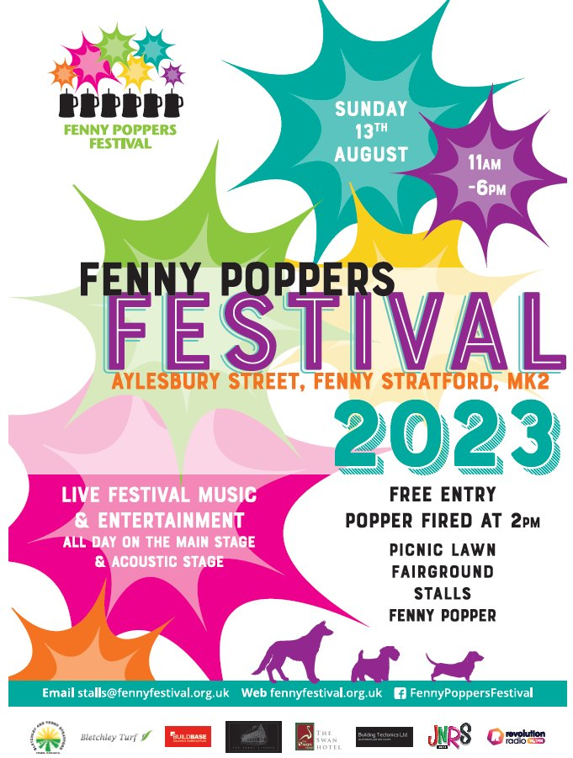
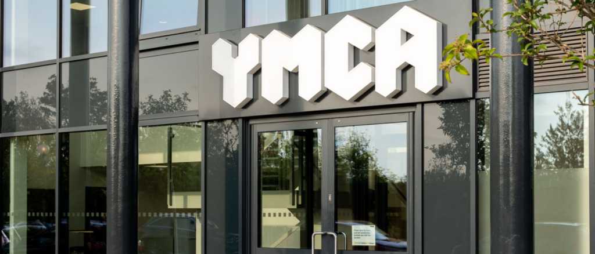
Grants
Fenny Poppers – We are the main sponsor to this ever popular event.
MK Pride Festival – Sponsorship package
YMCA – Soup Recipe Book
Read Easy MK South – Helping those who were let down by the education system
Friends of Bletchley Station – Bletchley Trail, Planters
Covid 19 Families – Inaugural MK remembrance event
Fenny Stratford Canal Festival – Support for infrastructure
Notes:
Over the past year the Community Committee have been very busy introducing new events, providing grants to various organisations and supporting the ongoing health and wellbeing needs of the Town including the free swimming and counselling sessions.
Highlights for the year have been the themed markets, Bletchley Big Street Eat, Christmas on Queensway and our newest event that reaches in to our diverse community, namely Iftar that was well attended and appreciated.
Grants this year included Bletchley and Fenny Stratford Town Council be the main sponsor of Fenny Poppers, the Electra Community boat, Canal festival and organisations such as YMCAs Soup Recipe book

Slide 6
Community Services
MKPA Play Sessions– Easter and summer play sessions for younger children at The Lakes, Leon Rec and Newton Leys.
Youth Clubs – social and leisure activities for Children aged 7 to 19.
Free Swimming – 8,535 provided
Counselling Services – up to 18 residents per quarter, receiving 9 sessions each.
Warm Spaces – Warm spaces, pop up cafés, film nights, Bingo housewarming sessions to support the cost of living crisis.
Water Eaton Community Larder – Financial support
Notes:
Over the past year the Community Committee have been very busy introducing new events, providing grants to various organisations and supporting the ongoing health and wellbeing needs of the Town including the free swimming and counselling sessions.
Highlights for the year have been the themed markets, Bletchley Big Street Eat, Christmas on Queensway and our newest event that reaches in to our diverse community, namely Iftar that was well attended and appreciated.
Grants this year included Bletchley and Fenny Stratford Town Council be the main sponsor of Fenny Poppers, the Electra Community boat, Canal festival and organisations such as YMCAs Soup Recipe book

Slide 7
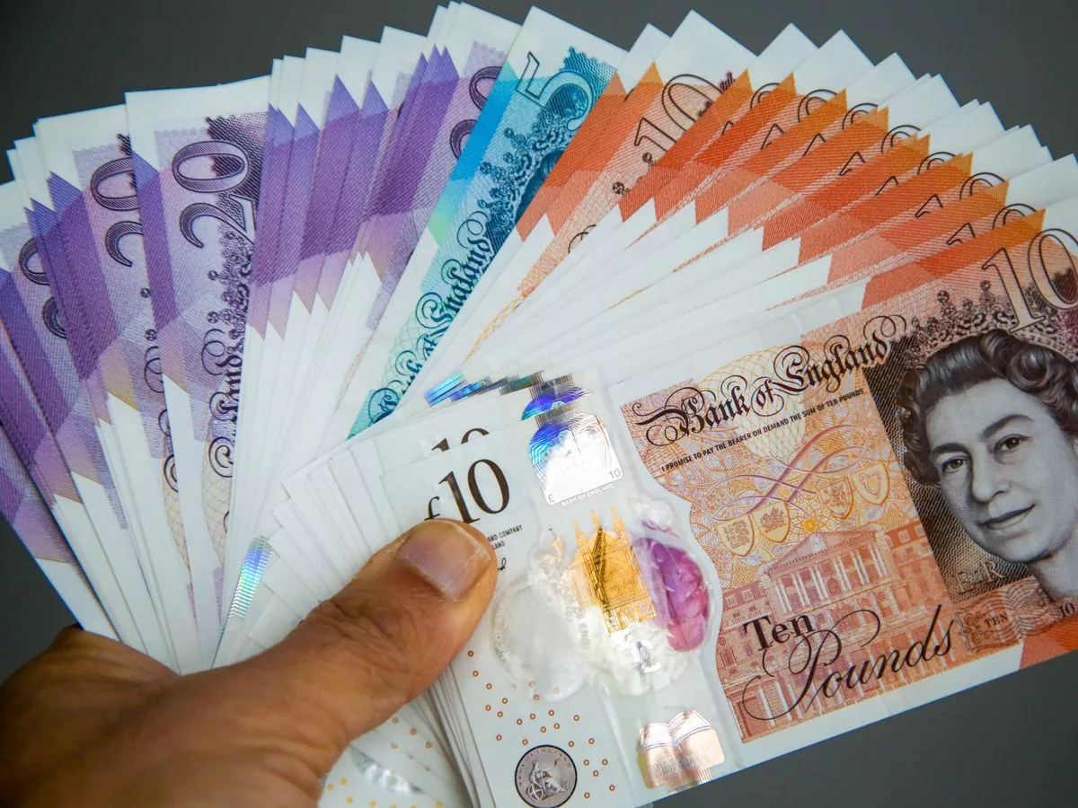
Finance and Governance
Committee
2023 - 2024
Keith Ely– Chair
Samantha Browne– Vice Chair

Slide 8

Finance and Governance
Underspend of approximately £85,000 because
Interest rates doubled during the year and problematic procurement of youth and advice services
Some of underspend was used to facilitate
additional community events remainder added to general reserves
and taken into account when setting the precept
Notes:
Over the past year the Community Committee have been very busy introducing new events, providing grants to various organisations and supporting the ongoing health and wellbeing needs of the Town including the free swimming and counselling sessions.
Highlights for the year have been the themed markets, Bletchley Big Street Eat, Christmas on Queensway and our newest event that reaches in to our diverse community, namely Iftar that was well attended and appreciated.
Grants this year included Bletchley and Fenny Stratford Town Council be the main sponsor of Fenny Poppers, the Electra Community boat, Canal festival and organisations such as YMCAs Soup Recipe book

Slide 9
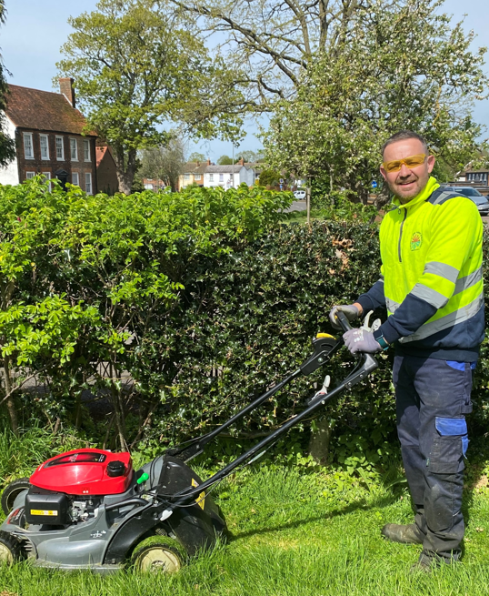
Environment and Planning
Committee
2023 - 2024
Ismail Hussein– Chair
Ron Haine– Vice Chair

Slide 10
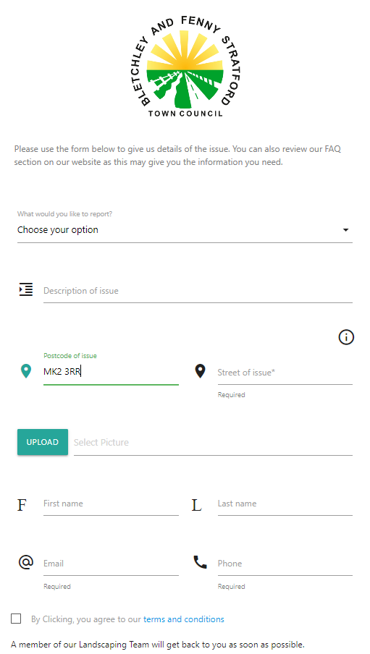
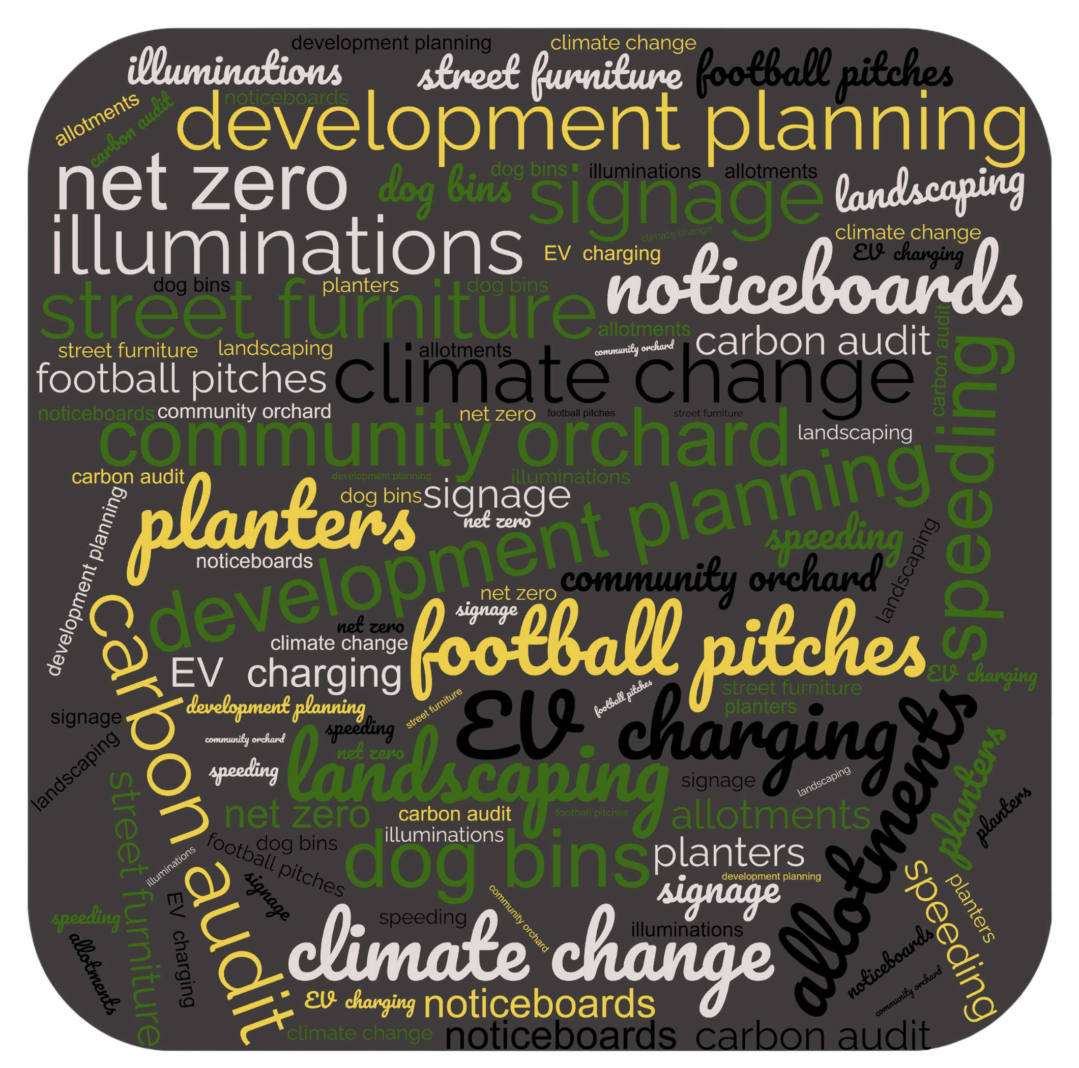

Environment and Planning
Notes:
Over the past year the Community Committee have been very busy introducing new events, providing grants to various organisations and supporting the ongoing health and wellbeing needs of the Town including the free swimming and counselling sessions.
Highlights for the year have been the themed markets, Bletchley Big Street Eat, Christmas on Queensway and our newest event that reaches in to our diverse community, namely Iftar that was well attended and appreciated.
Grants this year included Bletchley and Fenny Stratford Town Council be the main sponsor of Fenny Poppers, the Electra Community boat, Canal festival and organisations such as YMCAs Soup Recipe book

Slide 11
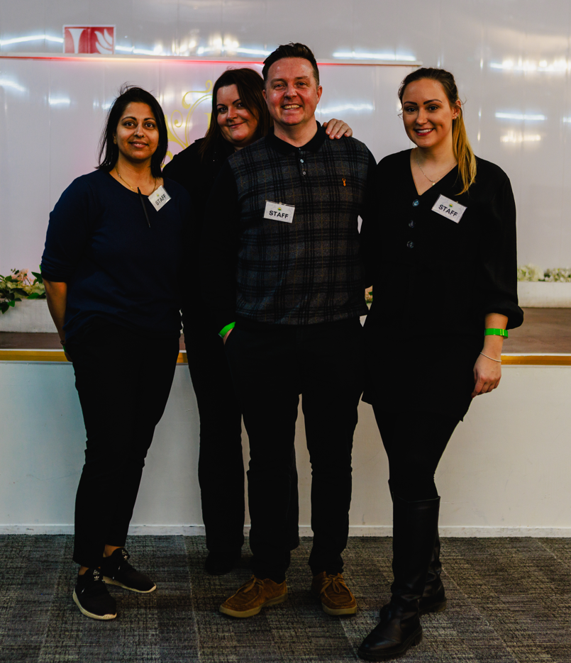
Employment Policy Committee
2023 - 24
Ed Hume– Chair
Gavin Bedford– Vice Chair

Slide 12
Human Resources
40% of council spend is on staff costs which are not apportioned over the different services
restructure during 2023-2024 to increase efficiencies and accommodate landscaping
13.2 full time equivalent employees, 4 entirely dedicated to landscaping
workload ever increasing as are expectations of the community and many members of the team need a high level of skills and experience to deal with these demands
Notes:
Over the past year the Community Committee have been very busy introducing new events, providing grants to various organisations and supporting the ongoing health and wellbeing needs of the Town including the free swimming and counselling sessions.
Highlights for the year have been the themed markets, Bletchley Big Street Eat, Christmas on Queensway and our newest event that reaches in to our diverse community, namely Iftar that was well attended and appreciated.
Grants this year included Bletchley and Fenny Stratford Town Council be the main sponsor of Fenny Poppers, the Electra Community boat, Canal festival and organisations such as YMCAs Soup Recipe book

