Slide 1
BLETCHLEY AND FENNY STRATFORD TOWN DEAL
May 2023

Slide 2
Background
Milton Keynes has been successful in securing an award of £22.7m, as part of the Government’s Town Fund, to invest in Bletchley and Fenny Stratford.
Milton Keynes was one of the 101 places eligible to bid for Town Deal funding. MK Council focused its bid on Bletchley and Fenny Stratford so it can make best use of current and future growth prospects, and the opportunities that will flow from East-West Rail.
The Bletchley and Fenny Stratford Town Deal Board was established in July 2020 to lead the bid and work with the community to ensure local people are involved in shaping the future of their area.
A total of 9 projects form the core of the Town Deal and each of these projects have had supporting business case submitted to the Department for Levelling Up, Housing and Communities (DLUHC), in order that grant funding can be drawn down and the projects move in to the delivery stages.

Slide 3
Board Composition
The Bletchley and Fenny Stratford Town Deal Board was established in July 2020.
It is chaired by John Cove, Chair of MK Dons Sport and Education Trust, and its members are drawn from a number of partners and organisations across Milton Keynes who have an interest in the Bletchley and Fenny Stratford area.
The Board is made up of the following core members:
John Cove - Chair of the Board. Chairman of Milton Keynes Dons FC Sport and Education Trust.
Councillor Pete Marland - Leader of Milton Keynes Council.
Delia Shephard - Clerk to Bletchley and Fenny Stratford Town Council.
Helen Hupton - Clerk to West Bletchley Council.
Angie Ravn-Aagaard - Treasurer of the Consortium of Bletchley Residents Associations (COBRA).
Ian Revell - CEO of MK Community Foundation.
Oliver Mytton - Deputy Director of Public Health at Milton Keynes Council.
Hilary Chipping - CEO at the South East Midlands Local Enterprise Partnership.
Iain Stewart MP - Member of Parliament for Milton Keynes South.
**Additional attendees are required on an ad-hoc basis depending on the agenda**

Slide 4
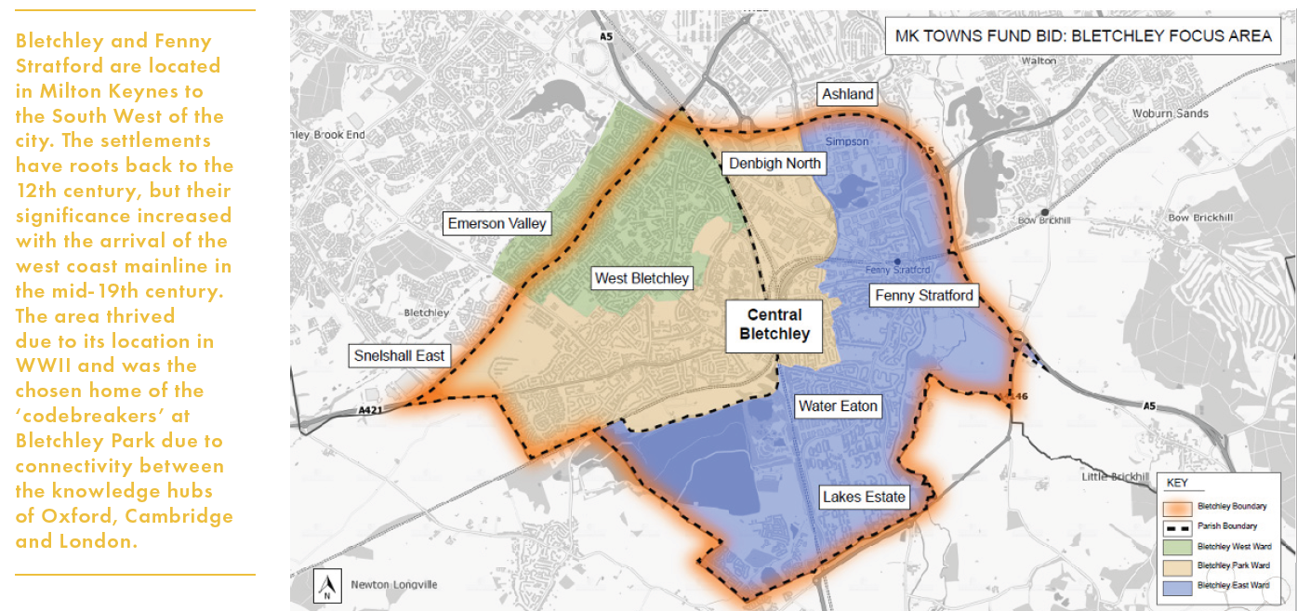
Intervention Area

Slide 5
The Projects
Innovation Hub/Centre
Revolving Development Fund (RDF)
Transport Hub
Public Realm Improvement (PRI)
Redway Improvements
Technology Park Bletchley
Transformation at Bletchley Park
Fibre Connectivity
Active Marketing of Vacant Sites (AMoVS)

Slide 6
Innovation Hub
Project Objective: | Redevelop the former Fire Station and Police Station sites into a new Innovation Hub
Business Case Progress: | Approved January 2023 first release of funds received April 2023
Project Value: | £3,662,345
Delivery Body: | Milton Keynes Development Partnership (MKDP)
Project Details :
The funding ask from the Towns Fund will support construction and fit out of an Innovation Hub within the wider mixed-use development scheme at the station gateway. The proposed site is currently occupied by two derelict and prominent brownfield sites in Bletchley – the former fire and police stations. These sites are located immediately west of Bletchley Station on the main approach to Bletchley Town Centre. The intention is to operate the Innovation Hub under a model that is commercially sustainable, led by a third party and does not require any revenue funding from MKCC. The current proposal, once delivered, is expected to be of interest to a suitable operator due to the location, fit out funding and rent expectations.

Slide 7
Revolving Development Fund (RDF)
Project Objective: | Remediation and development of up to 3.185 ha of dilapidated and underutilized land
Business Case Progress: | Approved March 2022, first release of funds received June 2022
Project Value: | £8,910,000
Delivery Body: | Milton Keynes Development Partnership (MKDP)
Project Details:
The Revolving Development Fund will facilitate the acquisition and re-use of run-down and dilapidated sites for new and improved uses (such as housing and commercial uses). Once the initial tranche of key sites in central Bletchley have been re-purposed, it is anticipated the fund will facilitate further development over a further two waves during a ten-year fund operating period. The fund will be focused on three waves of interventions in the area outlined in the recent Central Bletchley Urban Design Framework Supplementary Planning Document published by Milton Keynes Council. This will involve multiple sites to facilitate land assembly across the three fund revolutions. This affords the RDF operational flexibility to identify sites that will make a significant difference to the functioning and experience of the town centre.

Slide 8
Transport Hub
Project Objective: | To enable the delivery of a first stage of works to improve the links between Bletchley Railway Station and Bletchley Town Centre
Business Case Progress: | Approved January 2023 first release of funds received April 2023
Project Value: | £3,910,000
Delivery Body: | Milton Keynes City Council
Project Details:
The funding will enable delivery of a first stage of works to improve the links between Bletchley Railway Station and Bletchley Town Centre. The key proposed investments are: 1) Replacing Brunel Roundabout with a left in-left out priority junction. 2) Reducing Saxon Street to a single lane in each direction. 3) Improving access to the bus station and CEMEX site. 4) Introducing interim traffic signals to avoid the need for buses to U-turn. 5) Replacing the Princes Way Roundabout with a signalised junction. 6) Improving the pedestrian crossing and Redway infrastructure 7) Extending the Redway to the Brunel Centre.

Slide 9
Public Realm Improvements (PRI)
Project Objective: | Delivery of new public spaces, new/upgraded cycling and walking paths, new/upgraded community hubs, spaces and assets, reduction in crime, pedestrianisation, perceptions of the place by residents/business/visitors, land values
Business Case Progress: | Business Case approved March 2022. First funds received April 2023
Project Value: | £2,101,655
Delivery Body: | Milton Keynes City Council
Project Details:
The Towns Fund investment will enable the establishment of a Public Realm Improvement Fund to deliver public realm interventions in Bletchley and Fenny Stratford to improve the appearance, attractiveness, safety and usability of these areas. The area of operation will be the Town Deal Boundary. Investment will be coordinated with other Towns Fund projects, particularly the Revolving Development Fund, to maximise the impact of spend. The project will seek to bring about wider structural change to the layout and movement patterns within Bletchley town centre, improving the visual and physical connection between Queensway and the railway station and town to the west of the railway, making the town centre more visible and accessible to visitors arriving by train and tourists visiting Bletchley Park. This intervention, together with the improvements to the quality of the town centre public realm will generate increased footfall and dwell time in the town centre and support increased diversity of the retail and leisure offer.

Slide 10
Redway Improvements
Project Objective: | To design and deliver a Redway facility and highway improvement scheme. There will be 4 sections to the project
Business Case Progress: | Business Case approved March 2022, first release of funds received June 2022
Project Value: | £760,000
Delivery Body: | Milton Keynes City Council
Project Details:
The Towns Deal will provide funding to deliver Section 4 of the Blue Lagoon Scheme (Scheme 251) Redways route. The scheme is part of the Highways Committed Schemes to support current and future development. It will provide the link from the existing Redways in Bletchley from the Lakes Estate, Newton Leys and Blue Lagoon Nature Reserve to Bletchley Town centre via the highways infrastructure at Water Eaton Road. The section of the route is critical in unlocking the wider benefits and usability of the proposed sections of the route, Sections 1, 2 and 3, which would otherwise be disconnected from the wider road infrastructure.

Slide 11
Technology Park Bletchley
Project Objective: | To deliver learning equipment to support digital skills and capabilities in Bletchley and Fenny Stratford for over 500 students per annum
Business Case Progress: | Business Case approved March 2022, first release of funds received June 2022
Project Value: | £306,000
Delivery Body: | Milton Keynes College
Project Details:
Towns Fund investment will support the delivery of hardware and equipment to support digital skills development. The resource will be delivered in the enterprise lab of the South-Central Institute of Technology and will have the capability to be fully self-contained, flexible and mobile. The unit will enable the resource to be transported to other education settings to extend its use and impact across the area. The resource could also be used by other groups in the community such as the Rivers Centre and other local Community Centres that support adults as well as young people.

Slide 12
Transformation at Bletchley Park
Project Objective: | This project will involve the redevelopment of a significant wartime building (Block E) at Bletchley Park to facilitate the creation of a new dedicated learning facility, with eight new fully accessible classrooms and a high specification lecture theatre.
Business Case Progress: | Business Case approved March 2022, first release of funds received June 2022
Project Value: | £2,240,000
Delivery Body: | Bletchley Park Trust
Project Details:
The project is a key component of a wider scheme to renovate historic wartime Blocks A & E including major new gallery spaces and a collection centre. The renovation of these heritage assets is a unique opportunity to shed light on a crucial part of British WW2 history and open more of the site to the public. The project will provide learning opportunities and experiences to attract onsite and outreach visits, expanding the reach of the Bletchley Park stories and achievements. Learning activities at Bletchley Park are currently delivered from two permanent and two temporary classrooms. Planning consent requires these two temporary classroom spaces to be removed in Spring 2023. The proposed investment will increase capacity on site and enable Bletchley Park to work with neighbourhood schools to build engagement and increase visits from Bletchley and Fenny Stratford schools.

Slide 13
Fibre Connectivity
Project Objective: | To provide fibre connectivity to areas within the Town Deal area not yet connected to a fibre network
Business Case Progress: | Business Case approved January 2022, first release of funds received April 2022
Project Value: | £100,000
Delivery Body: | Milton Keynes City Council
Project Details:
The project will support the installation of fibre optic infrastructure to support full fibre connectivity The project will connect 12 premises in Park Gardens to the network to enable purchase of a service as required by each household/business. Most of the benefits will be social rather than economic but could also help to Improve perceptions of the place by businesses, though gaining a forecast improvement is not feasible for this relatively small deployment area Increased Number of people who are able work remotely at least some of the time – 40 residents in Park Gardens are likely to fall into this category **The contractor – City Fibre have indicated there may be issues relating to subsidy control, as a result the project is currently on hold awaiting the outcome of the Government project Gigabit scheme which will hopefully target the highlighted residents**

Slide 14
Active Marketing of Vacant Sites
(AMoVS)
Project Objective: | To promote the opportunities within the Bletchley Town deal area, attracting more investment, jobs and businesses.
Business Case Progress: | Business Case approved March 2022, first release of funds received June 2022
Project Value: | £710,000
Delivery Body: | Milton Keynes City Council
Project Details:
The strategic driver for this project is to attract more businesses to locate in Bletchley and Fenny Stratford by actively promoting the regeneration programme and showcasing the commercial opportunities arising from the Town Deal. This will emphasise the commercial advantages of the location such as good connectivity and price competitiveness compared to central Milton Keynes. This project recognises that whilst Milton Keynes has enjoyed strong economic growth in recent years, a more focused approach is required in Bletchley and Fenny Stratford. This project will play a role in supporting the wider programme of investment through the Towns Deal to showcase the investments being made in Bletchley and Fenny Stratford around fostering an improved public realm, enhanced connectivity and accessibility, improvements to skills & training and the supportive environment for start-up companies in the digital and media domains.

Slide 15
Programme Delivery Stage
As we move in to the delivery stage of the programme, the Town Deal Board will continue to meet throughout 2023 and beyond.
Minutes and papers are available on the website on the Groundbreaking Bletchley and Fenny Stratford website as well as Milton Keynes CMIS.
DLUHC will continue to actively monitor the progress of the programme and we will be bi-annually providing thorough monitoring and evaluation reports to them on all projects.
As the projects progress we will be improving communications and will be providing regular updates on progress and milestones through newsletters and website updates.

Slide 16
Any Questions?

